Slide 1

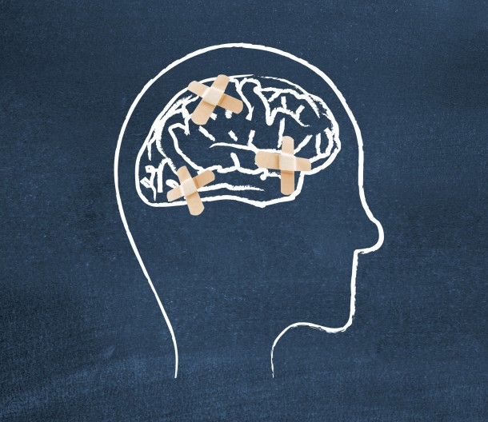
VINCENTIANS SERVING PEOPLE WITH MENTAL HEALTH ISSUES
Presented by eyitayo dada llb, llm, bl
April 14, 2018

Slide 2
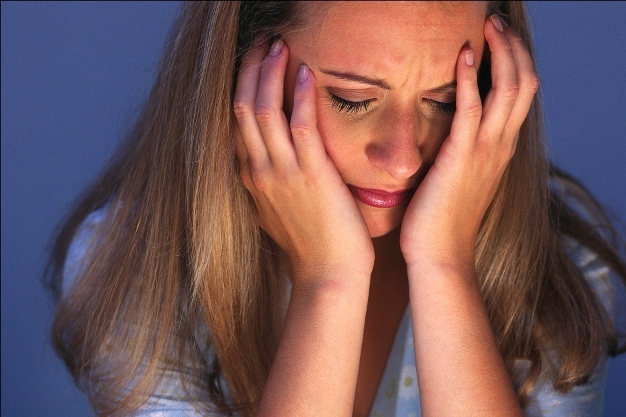
MENTAL ILLNESS
A champion named goliath, who was from gath, came out of the philistine camp. He was over nine feet tall. (NIV) 1 samuel 17:4
Meditation
Perhaps there are some threatening giants in your life – giants that make you and your faith feel small, helpless, and vulnerable. Pick up your slingshot, a couple of stones, and what faith you have in god and face them. What giants threaten your life and faith?

Slide 3
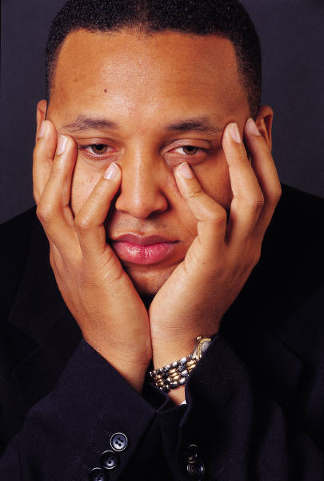
WHAT IS MENTAL ILLNESS
Any disease of the mind; the psychological state of someone who has emotional or behavioral problems serious enough to require psychiatric intervention

Slide 4

WHAT IS MENTAL ILLNESS
A mental disorder or mental illness is a psychological or behavioral pattern associated with distress or disability that occurs in an individual and is not a part of normal development or culture.
The recognition and understanding of mental health conditions has changed over time and across cultures, and there are still variations in the definition, assessment, and classification of mental disorders

Slide 5
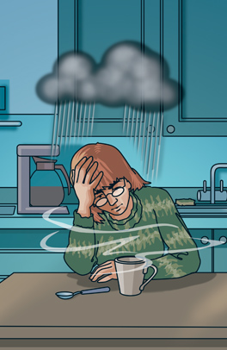
DEPRESSION
Problems and misfortunes are a part of life. Everyone experiences unhappiness, and many people may become depressed temporarily when things don't go as they would like.
Experiences of failure commonly result in temporary feelings of worthlessness and self-blame, while personal losses cause feelings of sadness, disappointment and emptiness.
Such feelings are normal, and they usually pass after a short time.

Slide 6
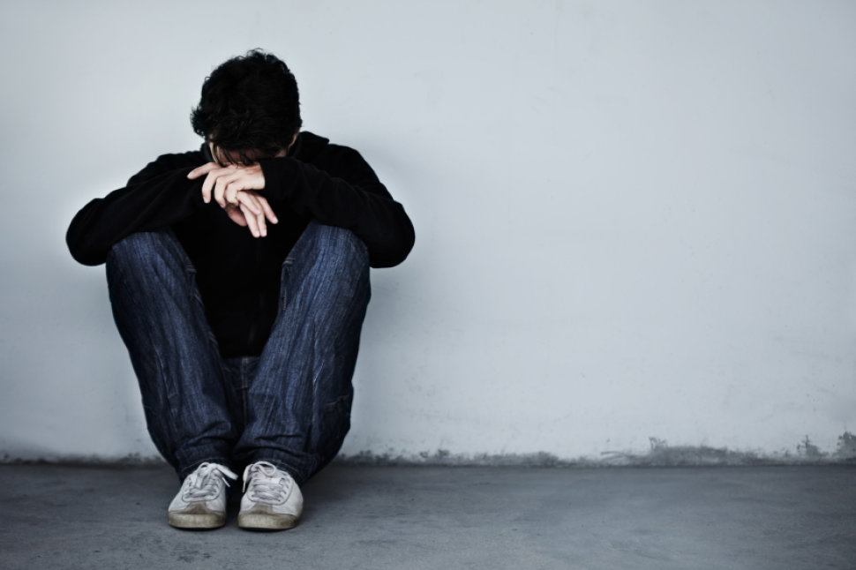
DEPRESSION cont’d
This is not the case with depressive illness.
Depression becomes an illness, or clinical depression, when the feelings described above are severe, last for several weeks, and begin to interfere with one's work and social life.
Depressive illness can change the way a person thinks and behaves, and how his/her body functions.

Slide 7

ANXIETY
Typically, general anxiety occurs when people are faced with a highly stressful situation like taking a test, a job interview or public speaking. Everyone experiences anxiety at some point in their life. It can cause hands to become clammy, the heart to beat faster and even dizziness.
If a person becomes preoccupied with fear, worry or experiences exaggerated reactions to stress it may be an indication of an anxiety disorder - phobia, panic or obsessive-compulsive.
In Canada today, one in eight people suffer from panic attacks or have an anxiety disorder.

Slide 8
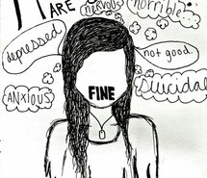
SUICIDAL THOUGHTS
Experts in the field suggest that a suicidal person is feeling so much pain that they can see no other option.
They feel that they are a burden to others, and in desperation see death as a way to escape their overwhelming pain and anguish.
The suicidal state of mind has been described as constricted, filled with a sense of self-hatred, rejection, and hopelessness.

Slide 9
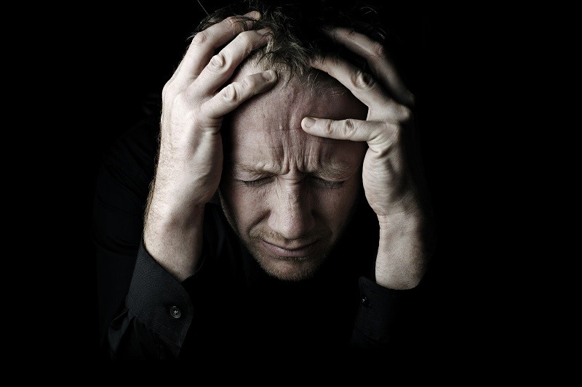
SCHIZOPHRENIA
Delusions are false beliefs that have no basis in reality. People with schizophrenia may think, for example, that someone is spying on them, listening to their thoughts, or placing thoughts in their minds.
Hallucinations most often consist of hearing voices that comment on behaviour, are insulting or give commands. Less often, people with schizophrenia may see or feel things that aren't there.
Disorganized thinking makes some people with Schizophrenia feel mixed up. In conversation, they may jump randomly from one unrelated topic to another. Depression and anxiety frequently accompany these feelings. The symptoms of schizophrenia vary greatly from person to person, from mild to severe. A specialist is needed to make the diagnosis, especially because there are no diagnostic tests.

Slide 10
SCHIZOPHRENIA cont’d
Once it has taken hold, schizophrenia tends to appear in cycles of remission and relapse. People with schizophrenia may experience one or all of these main conditions: delusions and/or hallucinations, social withdrawal, lack of motivation, thought disorders
Psychosis is a serious but treatable medical condition affecting the brain. It is characterized by some loss of contact with reality and can dramatically change a person’s thoughts, beliefs, perspectives, and behavior.
Sometimes people who have the breakdown are not even aware of it

Slide 11

BIPOLAR DISORDER
Bipolar disorder, also called manic depression, is an illness in which there are periods of serious depression, followed by episodes of markedly elevated or irritable moods or “highs” (in the absence of drugs or alcohol).
These mood swings are not necessarily related to events in the person’s life.
Bipolar disorder affects approximately 1% of the population; it typically starts in late adolescence or early adulthood and affects men and women equally.

Slide 12
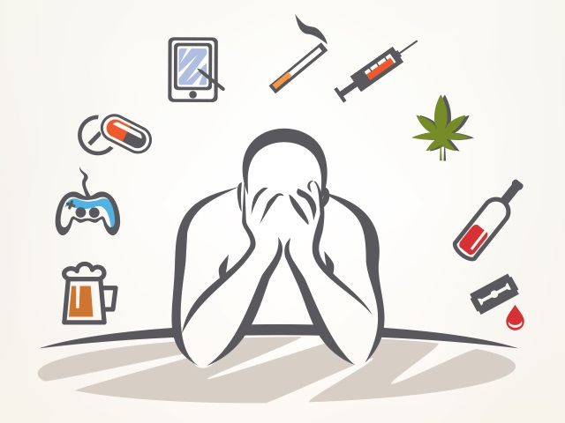
ADDICTIONS
The term "addiction" is used in many contexts to describe an obsession, compulsion, or excessive physical dependence or psychological dependence, such as: drug addiction, alcoholism, compulsive overeating, problem gambling, computer addiction, etc.
In medical terminology, addiction is a state in which the body relies on a substance for normal functioning and develops physical dependence, as in drug addiction.

Slide 13
ADDICTIONS cont’d
Addiction is generally associated with increased drug tolerance.
In physiological terms, addiction is not necessarily associated with substance abuse since this form of addiction can result from using medication as prescribed by a doctor.

Slide 14
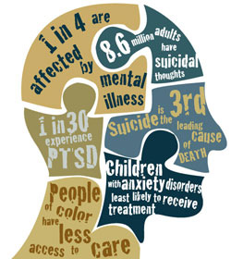
WHO CAN HAVE MENTAL ILLNESS?
People can develop mental illness or mental health issues at any stage in life.
Anyone can develop a mental illness, whether a person is rich or poor, well educated or illiterate; it does not matter what position a person holds in society. It also does not matter what ethnic group, religion or culture a person belongs to.

Slide 15
SOME COMMON INDICATIONS THAT A PERSON MAY HAVE MENTAL ISSUES
Exhibiting unusual behavior
Saying strange things
Hearing or seeing things other people don’t
Being unusually tired or unusually energetic
Believing someone or something is out to “get” or hurt them
Loss of interest in the things that they used to love
Stop taking care of their personal hygiene
Isolating themselves from family and friends
Loss of sleep and appetite

Slide 16
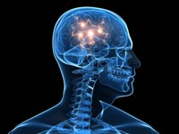

CAUSES OF MENTAL ILLNESS
Mental illness can be caused by biological, psychological or environmental factors

Slide 17

BIOLOGICAL
  Genetic
  Prenatal damage
  Brain defects and injury
  Substance abuse

Slide 18
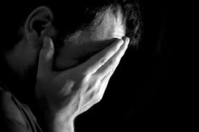
PSYCHOLOGICAL
Severe psychological trauma suffered as a child, such as emotional, physical, or sexual abuse
An important early loss, such as the loss of a parent
Neglect

Slide 19
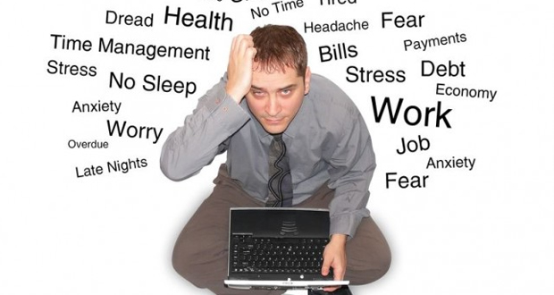
PSYCHOLOGICAL REACTIONS TO STRESS

Slide 20
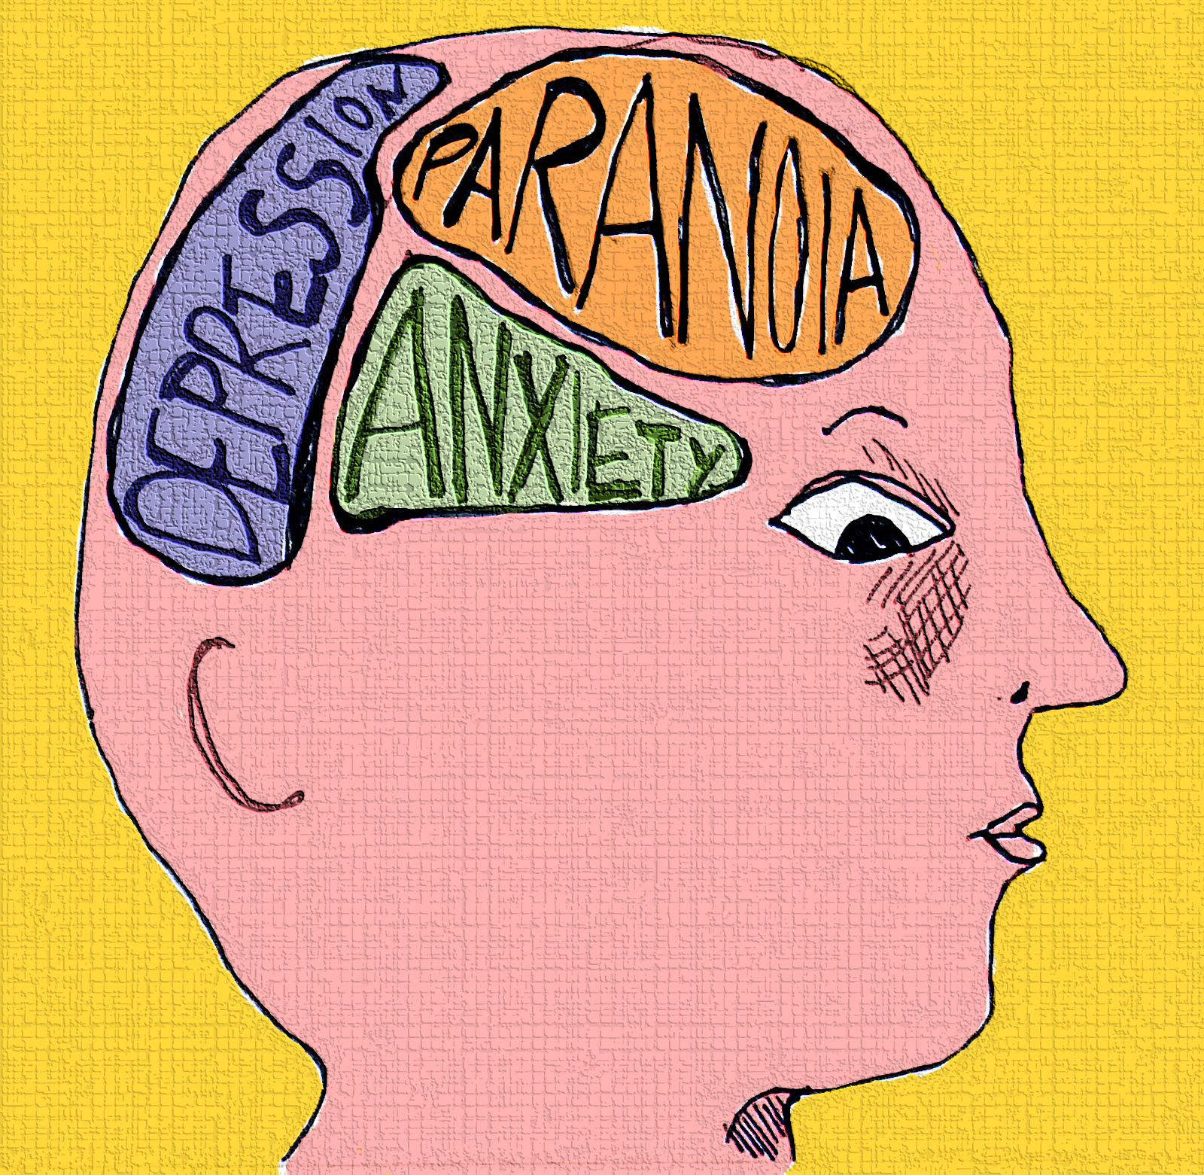
ENVIRONMENTAL
Death or divorce
A dysfunctional family life
Living in poverty
Feelings of inadequacy, low self-esteem, anger, or loneliness
Changing jobs or schools
Social or cultural expectations (for example, a society that associates beauty with thinness can be a factor in the development of eating disorders.)
Substance abuse by the person or the person's parents

Slide 21
Our role as Vincentians when serving individuals with mental health issues

Slide 22

WHO WE ARE AS VINCENTIANS…
Vincentians are people who are committed to bringing hope, love and assistance to the poor and others in need.
Your focus as Vincentians is being able to identify a need and not just feel pity and concern but to turn “concern into action”. This is done through direct compassionate service to those in need.

Slide 23


WHO WE ARE cont’d
Many of you are laymen and women with no specific formal training in dealing with people with mental health,
People who care and want to reach out and help.
The question is how can we do this in the most effective way, without compromising our boundaries, our safety and our professionalism?

Slide 24

identifying the signs of mental illness
As Vincentians it is very important that we are able to identify the signs of mental health, however, recognizing that we should not try to diagnose mental health

Slide 25

Why WE SHOULD NOT DIAGNOSE MENTAL ILLNESS
Even experienced professionals sometimes have difficulty in giving an absolutely, accurate diagnosis
Cultural, social and religious differences can lead to an individual’s symptoms being misread.
We want to be careful that we are not guilty of just labeling a person

Slide 26
WHY DO WE WANT TO RECOGNIZE THE SYMPTOMS
To assist an individual get help
To be aware of your own personal safety
To understand the individual at different stages of this illness and knowing if they seem to be getting worse
To address the safety of the family members particularly children

Slide 27
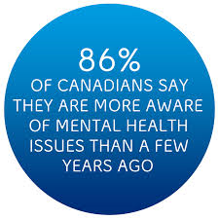
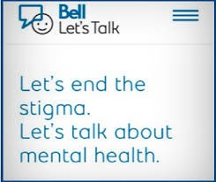

STIGMATIZATION WHICH LEADS TO:
  Denial by individual
  Denial by those close to individual

Slide 28
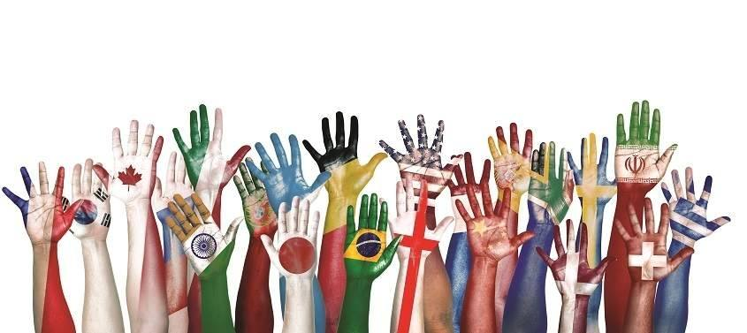

CHALLENGES OF SERVING THOSE WITH MENTAL HEALTH ISSUES
Cultural differences
Access to health care
Setting boundaries

Slide 29
PERSONAL SAFETY
  Protect yourself from legal prosecution
  Protect yourself from physical danger

Slide 30
SOME TIPS…………
    do not visit alone
    recognize when a person is escalating and leave if the person is not calming down
    be trained in non-violent crisis intervention and CPR
    be aware of your environment

Slide 31

TIPS cont’d…………
    Follow your instincts.
    Report and document any unusual incidents in any home you visit
    Remember you are not a professional counselor. Link them to the appropriate resources
    Ensure you have and follow a personal safety routine i.e. someone knows where you are visiting and you call to notify when you are leaving

Slide 32


TIPS cont’d…………
    Know when it is appropriate to call or notify authorities
      Anyone in imminent danger
      The suicidal individual
      Children being abused
      Individual is a danger to themselves

Slide 33

People with mental health issues are entitled to service

Slide 34

Some simple non-threatening tips you can give
Encourage them
  To be physically active, depending on their abilities
  Eat healthy, get enough sleep
  Seek help regarding underlying issues
  Seek help regarding mental health illness
  Stay connected with other people –family, friends
  People who can help
    Family doctor, psychologist, psychiatrist, nurse, social worker, case manager

Slide 35




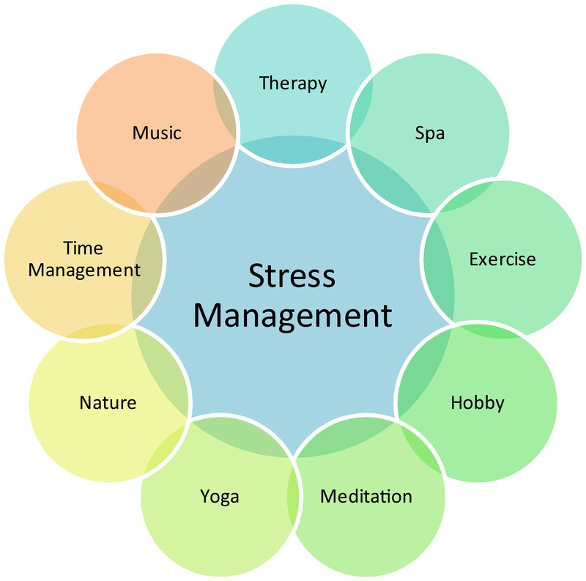




Slide 36
Mental illness and the criminal justice system
People with mental illness can get help from mental help community support services.
Different mental health programs offer support services in many provincial courts.

Slide 37

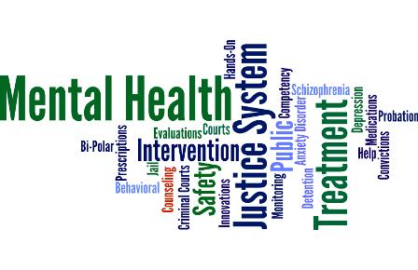
Criminal justice
Mental health support workers advocate on behalf of the individual, give advice, support and connect individual to other services and supports and can recommend mental health diversion.

Slide 38
Resources

Slide 39

Resources
Internet
311
CAMH
COTA
Habitat Services
Saint Vincent de Paul Special Works

Slide 40
SSVp special works
It is great to know that the Society of St. Vincent de Paul has unique homes that also cater to people with mental health issues and these can also act as resources for referrals etc for Vincentians

Slide 41
Resources CONT’D
There are many resources available for people who suffer from a mental health disorder or concurrent disorder. They include:
The Canadian Mental Health Association 416-977-5580 www.cmha.ca
The Centre for Addiction and Mental Health 416-535-8501 www.camh.net
Mental Health Service Information Ontario 1-866-531-2600 www.mhsio.on.ca
Older Persons’ Mental Health and Addiction Network 416-593-4094 www.ontarion.cmha.ca/opmhan
Drug and Alcohol Registry of Treatment 1-800-565-8603 www.dart.on.ca
Victim Services Program of Toronto (Domestic Violence) 416-808-7066 www.victimservicestoronto.com
Gerstein Crisis Centre Crisis Line: 416-929-5200 www.gersteincentre.org
SVDP – Toronto Central Council / Special Works 416-364-5577 www.svdptoronto.org
211 – A Provincial Information and Referral Service Dial “211” www.211Toronto.ca or
www.211Ontario.ca

Slide 42
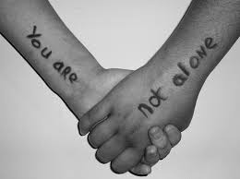
Resources CONT’D
Other community resources include:
FAMILY PHYSICIAN
HOSPITAL / 911
CHILD WELFARE AGENCIES
WITHDRAWAL MANAGEMENT CENTRES
COMMUNITY DROP-IN CENTRES
IMMIGRATION CENTRES
COMMUNITY HEALTH CENTRES
COMMUNITY CARE ACCESS CENTRES

Slide 43
Conclusion
In conclusion as Vincentians you are able to play a vital role in the lives of individuals with mental health issues.
You can make a difference.
Just as the Bible says: wisdom is the principal thing. In all thy getting, get understanding.
Turning concern into action.

Slide 44


