Slide 1
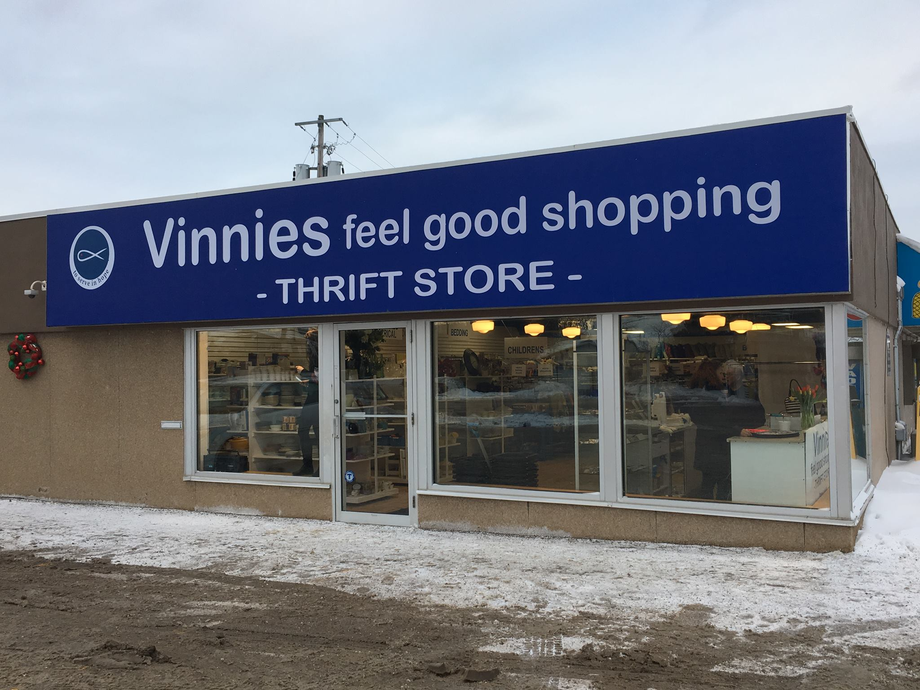
Society of Saint Vincent de Paul
The Importance & Roles of Store Committees
and Managers
ONRC Meeting
April 13, 2019
Notes:
We have these wonderful special works called stores. We all know that this is usually the first contact with our “friends in need” No matter what city you are in, what province, anywhere in the world you can always find a Saint Vincent because of our stores. Truly the face of our society

Slide 2
$28 Billion Industry
Notes:
We are also part of this 28 billion dollar industry across Canada.

Slide 3
Ontario
Notes:
10.3 Billion in Ontario! The number is staggering. So who do we entrust with this

Slide 4
Who is responsible?
Notes:
- Look at what we do and who do we put in charge of this? We find the right person with experience and we entrust them to look after this.

Slide 5
Our Biggest Asset
We need to
nurture and support
Notes:
We all come and go our managers are all in for their career. Why would we not nuture and support our biggest asset. Managers and staff are part of our extended Vincentian Family. We take care to nuture our relationships with each other we need to extend that.

Slide 6
Store
Chair
Store Committee
Managers
Notes:
We hire the right people to manage our assets. So who do they report to?

Slide 7
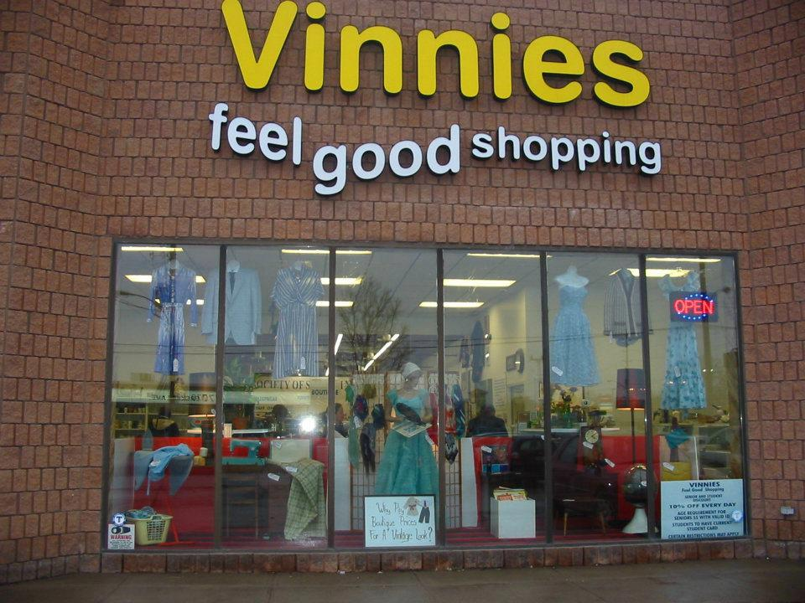
Responsibilities
To support the Manager in achieving their goals
Success of store operations depends on good communication and adhering to the chain of command of Council, Store Committee and Store Management.
The Committee does not become involved in day-to-day operation of stores
Notes:
Why would we thing we know better? Most of us come from different backgrounds and more often than not we have no Thrift store expertise.

Slide 8
Duties and Responsibilities
in Conjunction with Store
Director/Manager
Notes:
We are all on the same team.

Slide 9
Set policies and goals for
Store operations
Notes:
These are things that a store committee and chair help/work on

Slide 10
Develop a business plan for the stores and review at least annually
This Photo by Unknown Author is licensed under CC BY-SA-NC
Notes:
Just like any other part of our Society Standing Still and doing nothing or doing the same old same old doesn’t propel us forward.

Slide 11
Set policies and goals for Store operations
Develop a business plan for the stores and review at least annually
Prepare an annual budget in cooperation with store management and submit to the Council Board of Directors
Identify with management the goals for the year and incorporate into the annual budget

Slide 12
Institute the use of a personnel manual for all SVDP employees
Insure performance reviews are made for all employees annually
Set policies for free distribution to individuals, conferences or other agencies; use a referral system
Establish principles of honesty for all store personnel

Slide 13
Ensure monthly, quarterly and annual reports are made to the Council, Bishop, National Office of the Society and others as required
Provide a barrier-free environment for the handicapped
Chairperson should provide a copy of meeting agendas in advance of meetings

Slide 14
Store Committee vs Director/Manager
A critical item is to establish boundaries between the Store Committee and Store Director/Manager. The Store Committee sets policies and evaluates the Store Director/Manager on the execution of the policies.

Slide 15
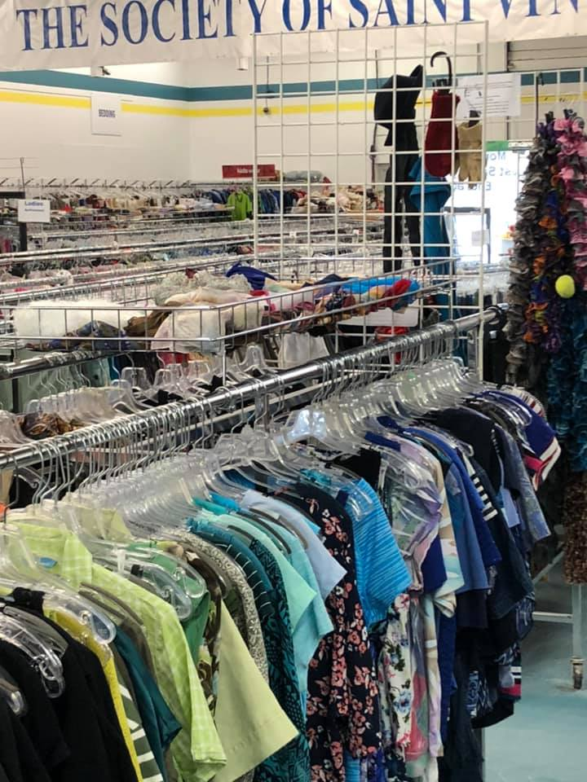
The Store Director/Manager manages the day-to-day operation of the stores and manages the people employed or volunteers that run the store. It is critical that the committee not interfere with the managers duties
Notes:
If members of any level from committees to PC members go to the stores to volunteer – They switch hats and the manager is now in charge. So remember you can get let go from being a volunteer lol

Slide 16
Store Chair
Reports to
Particular Council
Notes:
The information from the store is shared with Store Chair.

Slide 17
PC Roles
The board is responsible for the highest level of decision making and legal authority
By law, it is ultimately accountable for, and has authority over resources and activities
Articulates and communicates the vision to members, clients, donors, staff, volunteers and community
Through policy they defines the parameters within which we will carry out our work

Slide 18
Ineffective Board Types

Slide 19
Too involved in operational details
Seen as wasting time and potentially making bad decisions on matters it knows little about
Notes:
Hands in – demanding more bag sales etc.

Slide 20
Behaves Erratically
Board sometimes dabbles in operational details while at other times wanting only to “rubber stamp”
Notes:
Well wages too high and in same breath everyone gets raises.

Slide 21
Too Removed
Board ratifies without meaningful debate, only on the recommendations of the President
Notes:
Bored at meetings and even if some doubt goes along with everyone else

Slide 22
Particular Councils
NIFO
Notes:
Best Rule for PC’s - Noses in Fingers out!
Be informed (from Committee) but don’t go in demanding changes

Slide 23
Particular Council
Store
Committee
Store
Manager

Slide 24
What could possible
go wrong???
Notes:
Mistakes everyone has made!

